Slide 1
Nashville,
Brown County
CRI Presentation B
David Terrell
Director, Indiana Communities Institute, Ball State University
Director, RUPRI Center for State Policy, Rural Policy Research Institute
drterrell@bsu.edu

Slide 2
Questionnaire Statistics
35 responses to leadership questionnaire
Responses include council members, local government, commissioners, etc

Slide 3
Knowledge of Community Plan
Please check the box for each comprehensive community plan that you are familiar with for your community.
Answer Options | Response Percent | Response Count
a. City or town(s) plan | 48.6% | 17
b. County plan | 71.4% | 25
c. Regional plan (multiple counties) | 8.6% | 3
d. I do not know of any existing comprehensive plan for my community area | 20.0% | 7
When was it last updated? (Example: County in 2005, city in 2010) If unknown, you may leave this blank. |  | 20
answered question |  | 35
skipped question |  | 0

Slide 4
Internal Alignment
Lower numbers = more agreement among responses
# Responses | Production | Wholesale | Retail | Residential | Recreation
35 | 1.748 | 1.633 | 2.054 | 1.761 | 1.661

Slide 5
Community PWR³ Rankings
Least
Promising
Least
Promising
Most
Promising
Most
Promising

Slide 6
Population Growth Rate

Slide 7
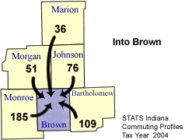
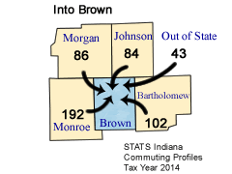
Commuting into County
Source: STATS Indiana Annual Commuting Trends Profile (2004, 2014)

Slide 8
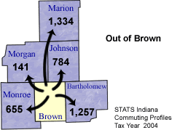
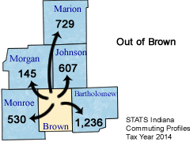
Commuting out of County
Source: STATS Indiana Annual Commuting Trends Profile (2004, 2014)

Slide 9
Occupations (What you do)

Slide 10
Industries (Where you work)

Slide 11
Poverty Rate

Slide 12
Median Household Income

Slide 13
Exportable/Non-Exportable Sector Employment

Slide 14
Income Inequality

Slide 15
Housing Occupancy

Slide 16
Age of Housing

Slide 17
Educational Attainment

Slide 18
Educational Attainment
Source: American Communities Survey, 5 Year Estimates, Table DP02 (2010-2014)

Slide 19
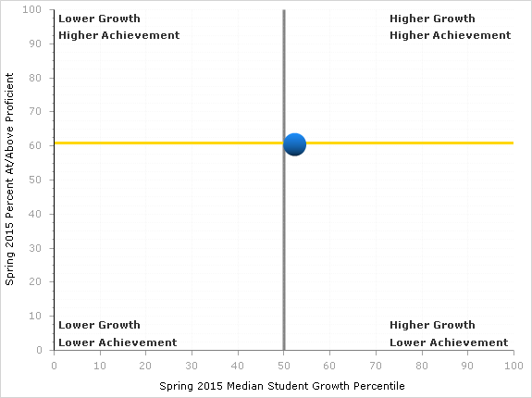
School Corporation Performance: Math
Source: Indiana Department of Education (2015)
Brown County School Corporation

Slide 20
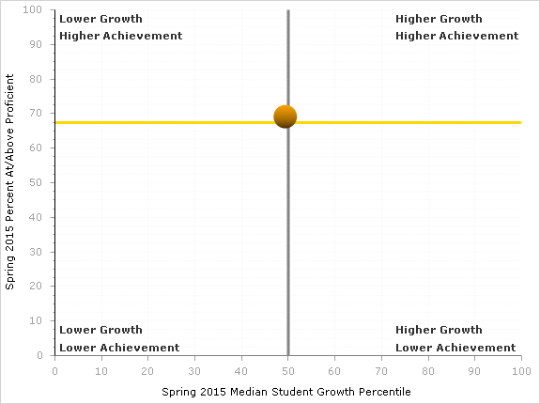
School Corporation Performance: English
Source: Indiana Department of Education (2015)
Brown County School Corporation

Slide 21
End-of-Course Percent Passing
Source: Indiana Department of Education (2015)

Slide 22
Why Is This Important?
In other words….
So What?

Slide 23
20th Century Economic
Development Policy
Luring investment and jobs
Locally based
Incentives, infrastructure & job training
Assumes people move to jobs
Transactional/commodity mindset

Slide 24
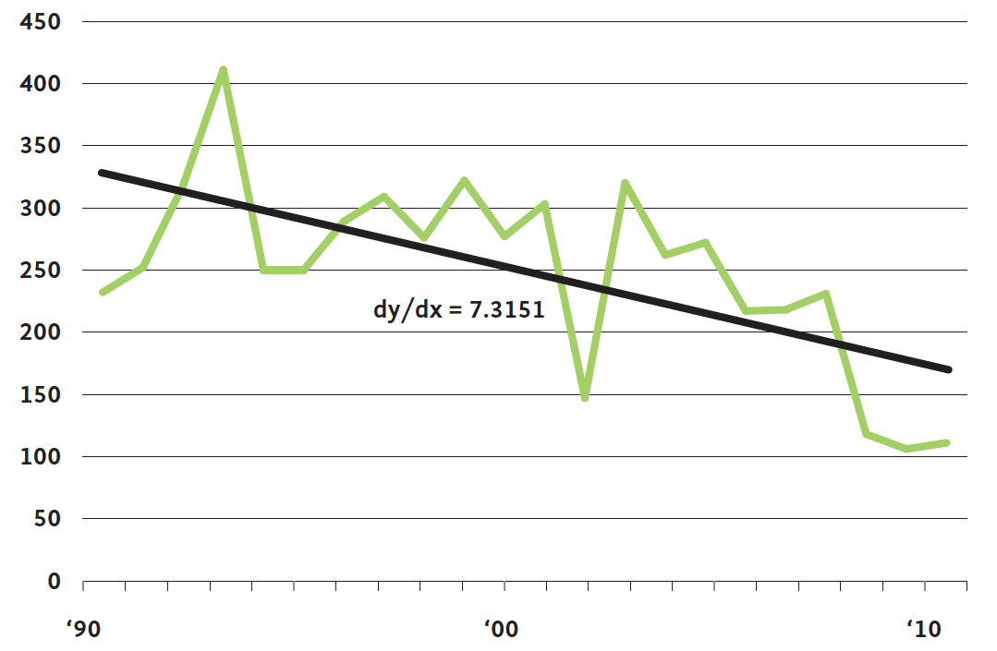
Birth of Manufacturing Firms with 500+ Employees, USA

Slide 26
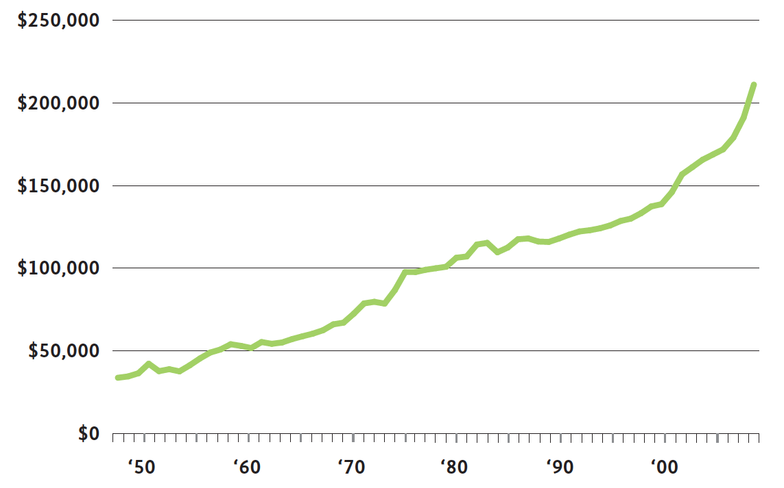
Capital-to-Labor Ratio in US Manufacturing

Slide 27
Indiana’s Manufacturing Paradox
88% of US manufacturing job loss in 2000-2010 is due to productivity gains, not to offshoring
For Indiana in the coming decade:
  125,000 new manufacturing job openings per year due to turnover and retirements
  70,000 new entrants into the labor force
  Skills gaps

Slide 28
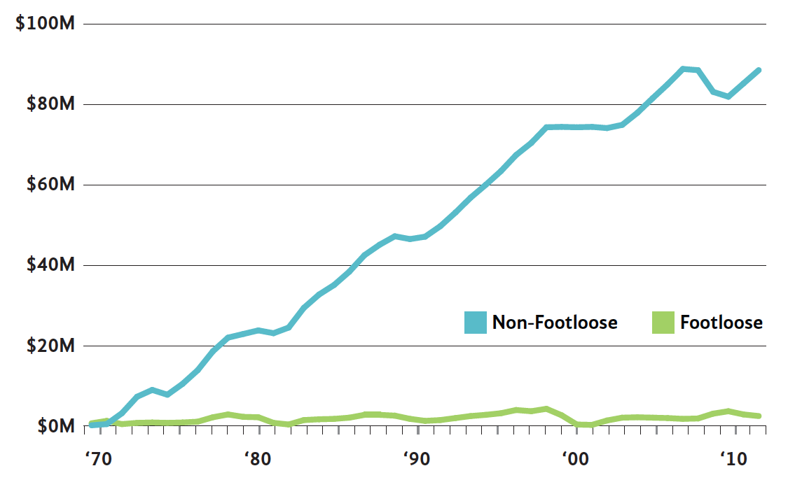
Cumulative Job Growth in Footloose/Non-Footloose Firms, USA

Slide 29
Why did you move here and select your home?

Slide 30
New Paradigms – Job Creation
Job creation does not necessarily lead to population growth.
Capital investment in equipment does not necessarily tie to greater job creation.
Most new jobs are not in footloose industries.

Slide 31

Talent
Attraction
Retention
Development

Slide 32
21st Century Community Economic Development Policy
Luring people (talent attraction, retention,
and development)
Locally based (traditional ED becomes regional)
Quality of services, amenity based
Assumes jobs move to people
Value-added mindset – “The value proposition”

Slide 33
What Is Primacy of Place?
A community’s strategic decision to dedicate resources to improving life experiences for residents, businesses and visitors.
Purposeful policies that focus on building infrastructure and provide services that lead to better quality of place and higher levels of human capital.

Slide 34
Key Components of
Primacy of Place
  Arts, culture, and tourism
  Community design
  Community collaboration for educational excellence
  Community well-being
  Municipal governance
  Community readiness for change

Slide 35
Operational Parameters
  Collaboration – Non-traditional partners
  Strategic mindset and action
  Regional value-added
  Policies to match stated priorities
  Resiliency mindset
  Meaningful community conversations
  (priorities and requirements)

Slide 36
Priorities and Timing
Fully Integrated Talent Attraction (Programs & Capital Investment)
Amenities Development
(Quality of Place Development)
Infrastructure, Safety, & Health
Education, Social Service
‘Safety Net’

Slide 37
Conclusions
Jobs move to where the people want to live
People want good schools and amenities
Primacy of Place matters
We need to answer the “Whys”
We need to demonstrate value-added
  To our citizens
  To our region

Slide 38
Questions?
David Terrell
Director
Indiana Communities Institute
Ball State University
drterrell@bsu.edu
812-599-2201

Slide 39
Thank You!
For more information, visit http://cri.cberdata.org and select “FAQs for Communities”

